Slide 1

HPML Group 11/01/2023
Deep Learning
Introduction Series
Bryan Cardenas
Monica Rotulo
Caspar van Leeuwen
Robert Jan Schlimbach

Slide 2
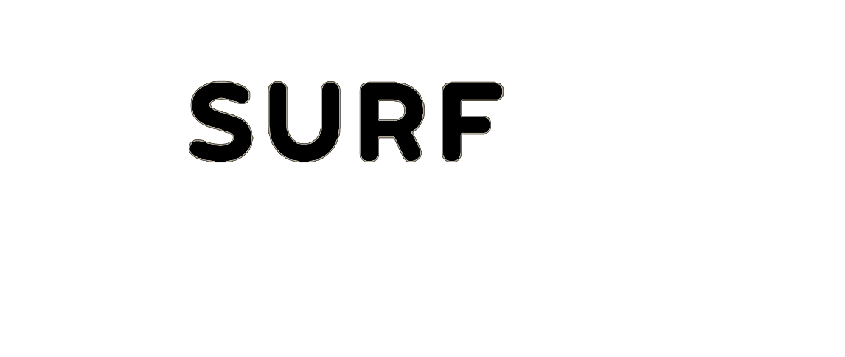
Prerequisites
Programming
R / Python
Statistics, Calculus
Machine Learning
Parallel Computing

Slide 3
Plan for Today
01.
02.
03.
04.
Language Modelling
Recurrence and Transformers
High Performance
How can I train efficiently?
General Introduction
Machine Learning
Neural Networks
Dense and Convolutions

Slide 4
11/01/2023
Machine Learning
High Performance Machine Learning Group

Slide 5
What ML is not:
Mimicking human intelligence
Robotics
Deep Learning

Slide 6
What ML is not:
Mimicking human intelligence
Robotics
Deep Learning
“
ML is the study of algorithms that can improve through experience and by the use of data. It is seen as part of Artificial Intelligence
~ Wikipedia

Slide 7
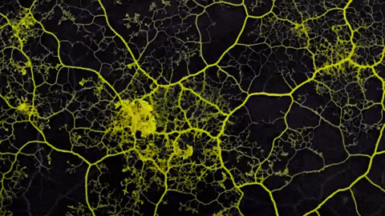
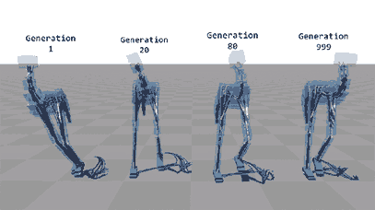
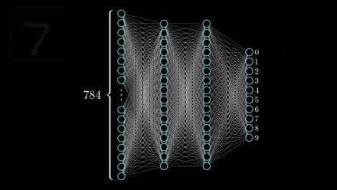
Artificial Intelligence
Having computers to exert
Intelligent behaviour

Slide 8
Artificial Intelligence
Machine Learning
Having computers to exert
Intelligent behaviour
Perform tasks without
Explicitly programmed
from data

Slide 9
Artificial Intelligence
Machine Learning
Deep Learning
Having computers to exert
Intelligent behaviour
Perform tasks without
Explicitly programmed
from data
Use deep neural networks

Slide 10
Why Machine Learning?
Think of a simple decision tree

Slide 11
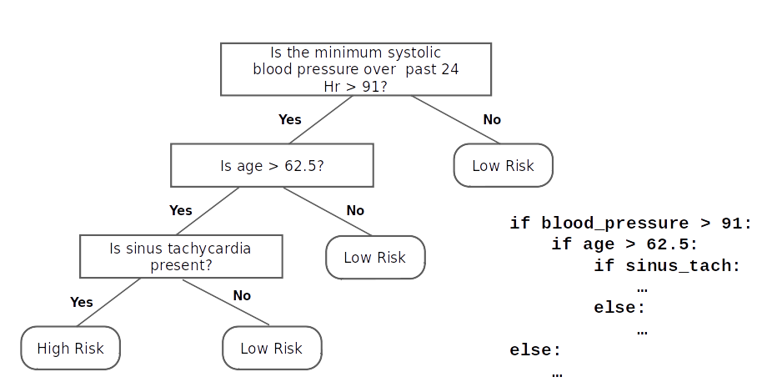
Why Machine Learning?
Think of a simple decision tree

Slide 12
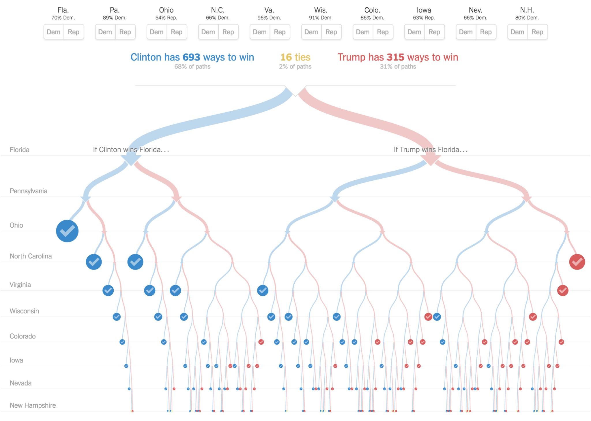
Why Machine Learning?
Think of a hard decision tree

Slide 13
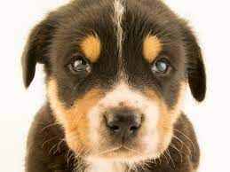
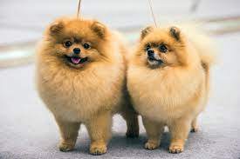

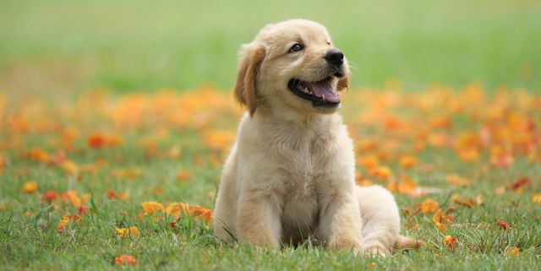

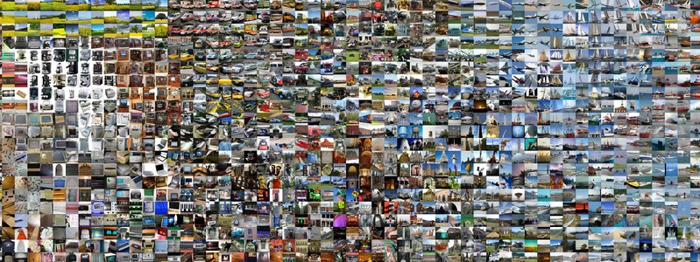
What is a dog?
Uncountable features that define a dog
We want an automatic way of learning these features
Driven by Data

Slide 14
11/01/2023
Neural Networks
High Performance Machine Learning Group

Slide 15
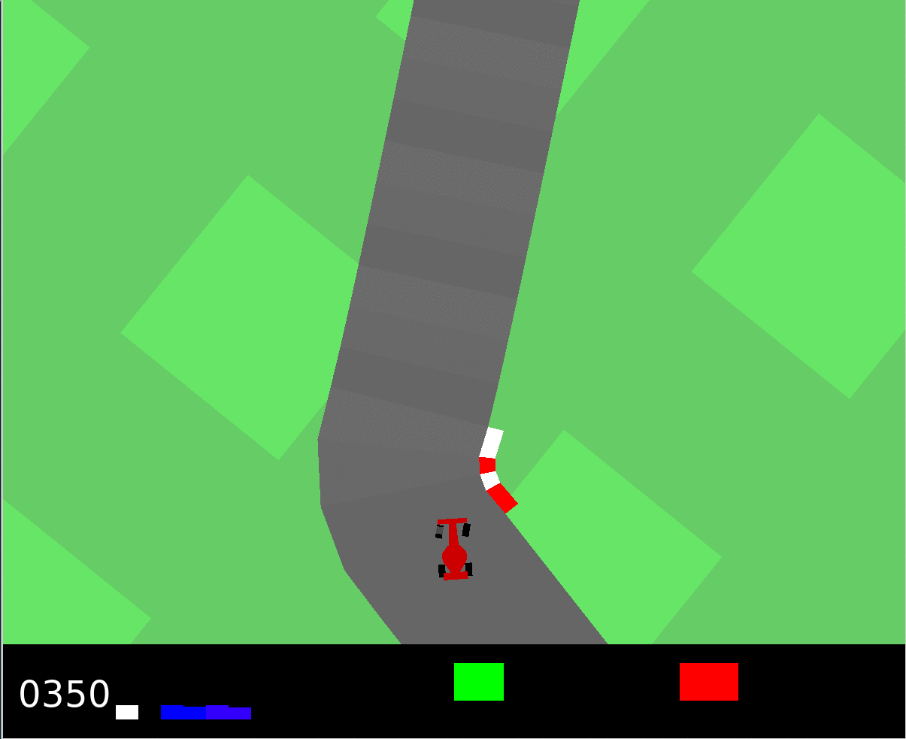
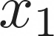
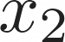
Categories of Machine Learning
01.
02.
03.
Supervised
Unsupervised
Reinforcement
Learn from labels
Regression, Classification
Detect Patterns in the data
Clustering, Dimensionality Reduction
Learn from the environment
Control, gaming

Slide 16
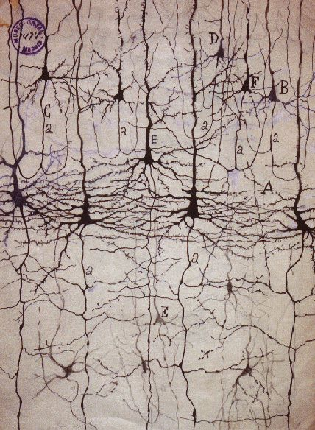
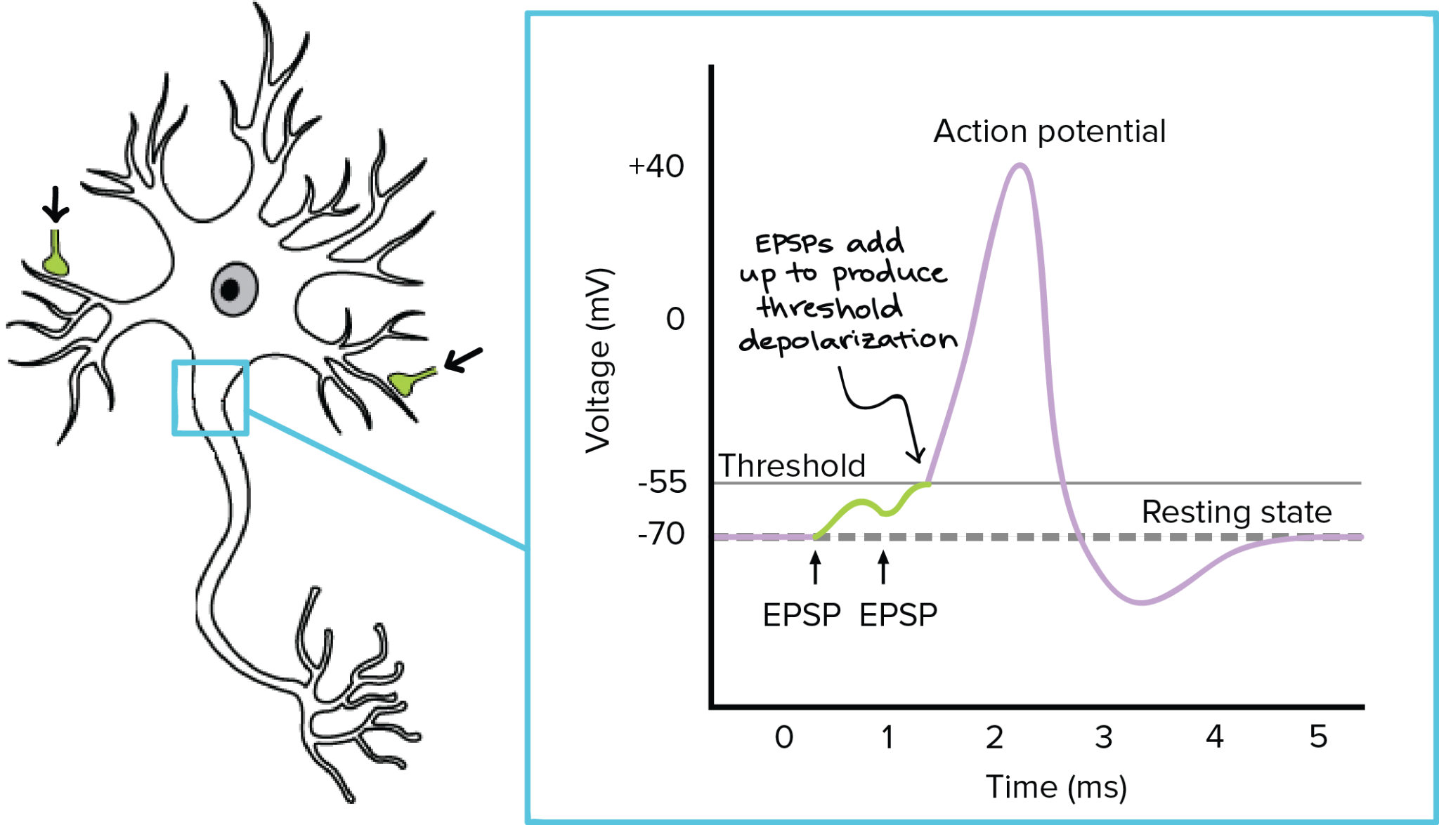
Biological Neuron
A neuron inhibits or excites a signal picked up from its receivers
Only fires if a threshold is reached and is connected to thousands of others.

Slide 17
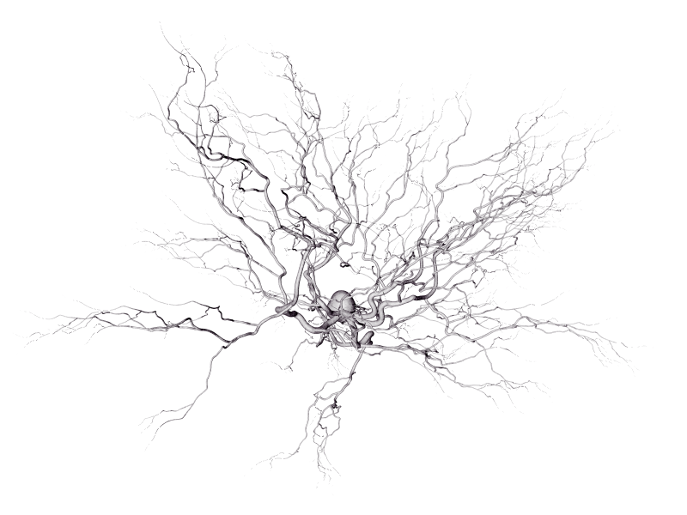
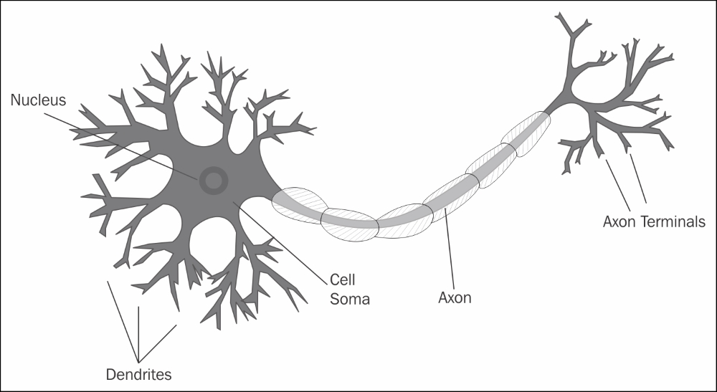
Biological Neuron
A neuron inhibits or excites a signal picked up from its receivers
Only fires if a threshold is reached and is connected to thousands of others.
Humans have around 80 billion neurons and trillions of connections

Slide 18
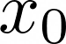
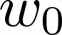
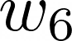
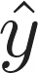
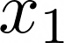
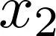
Anatomy of an Artificial Neural Network
Don’t model the biological neuron precisely

Slide 19
Anatomy of an Artificial Neural Network
Don’t model the biological neuron precisely
Inputs
Bias
Weights
Dot product
Non-linear activation

Slide 20
Anatomy of an Artificial Neural Network
Don’t model the biological neuron precisely
Use a (deep) neural network to approximate an unknown function
Inputs
Bias
Weights
Dot product
Non-linear activation

Slide 21
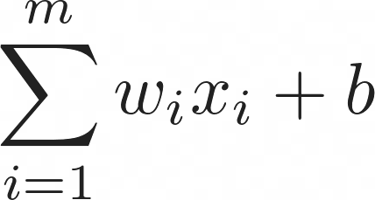
Anatomy of an Artificial Neural Network
Don’t model the biological neuron precisely
Use a (deep) neural network to approximate an unknown function
Inputs
Bias
Weights
Dot product
Non-linear activation

Slide 22

Anatomy of an Artificial Neural Network
Don’t model the biological neuron precisely
Use a (deep) neural network to approximate an unknown function
Inputs
Bias
Weights
Dot product
Non-linear activation

Slide 23
Anatomy of an Artificial Neural Network
Don’t model the biological neuron precisely
Use a (deep) neural network to approximate an unknown function
Inputs
Bias
Weights
Dot product
Non-linear activation
Easy to compose and easy to vectorize
Fits current compute paradigm

Slide 24
The Perceptron and Activation
Binary Classification Task
0

Slide 25
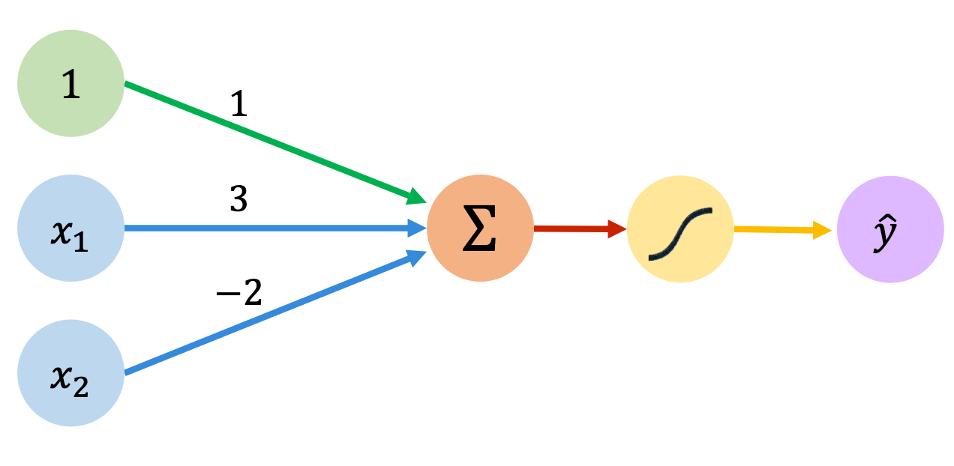
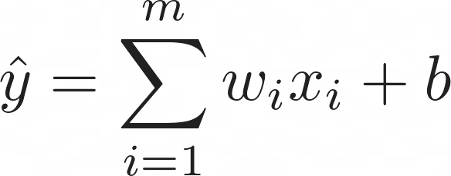
The Perceptron and Activation
Binary Classification Task
0

Slide 26
The Perceptron and Activation
Binary Classification Task
0

Slide 27
The Perceptron and Activation
Binary Classification Task
0

Slide 28
The Perceptron and Activation
Binary Classification Task
0

Slide 29
The Perceptron and Activation
Binary Classification Task
0

Slide 30
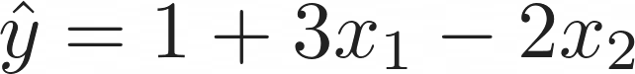
The Perceptron and Activation
Binary Classification Task
0

Slide 31
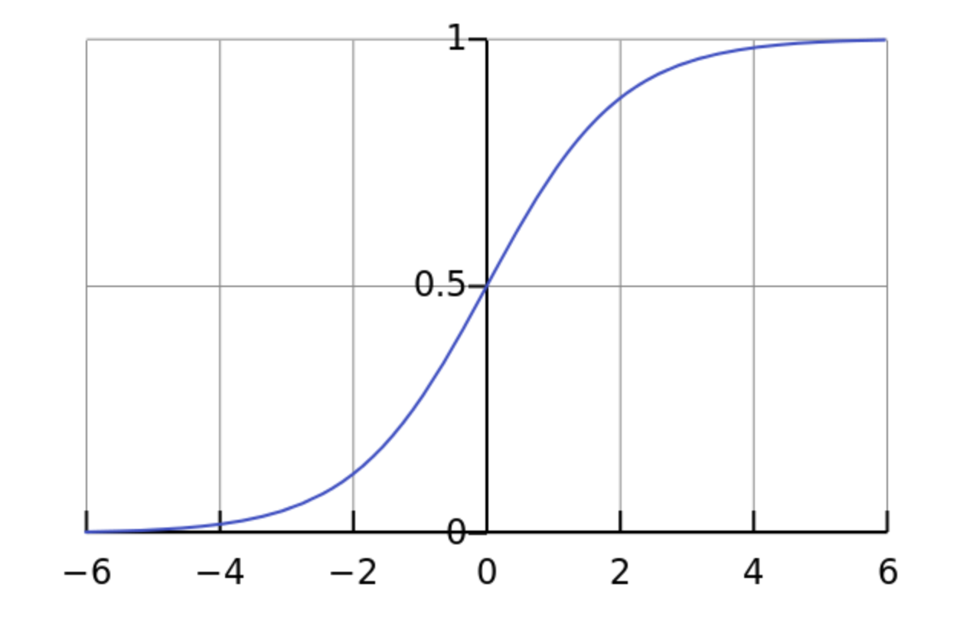
The Perceptron and Activation
Binary Classification Task
Sigmoid
0

Slide 32
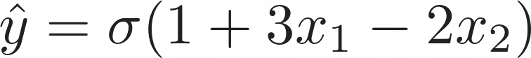
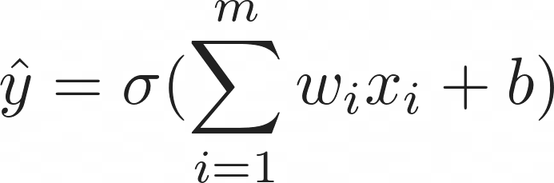
The Perceptron and Activation
Binary Classification Task
Sigmoid
0

Slide 33
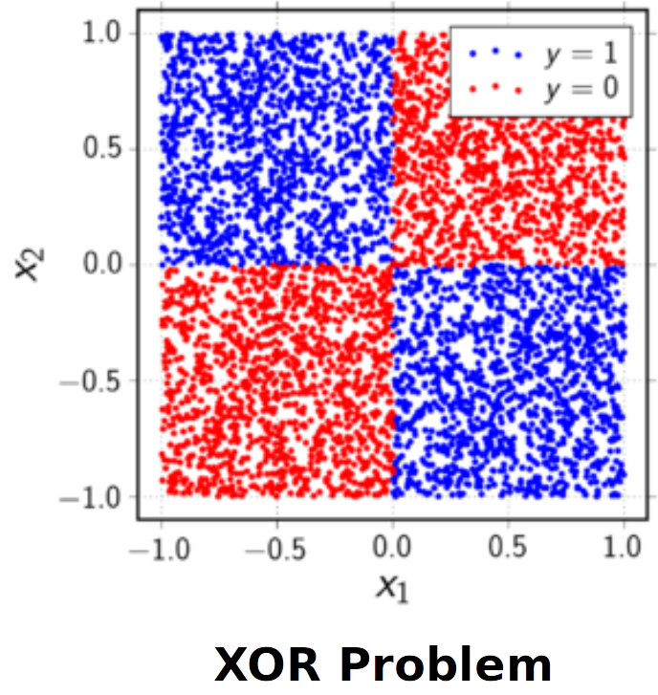
Limitations of Linear Single Layer Classifiers

Slide 34
Limitations of Linear Single Layer Classifiers
Possible Solutions
Add more layers (deep learning)
Map into another (higher dimensional) space
We need to be able to automatically extract features

Slide 35
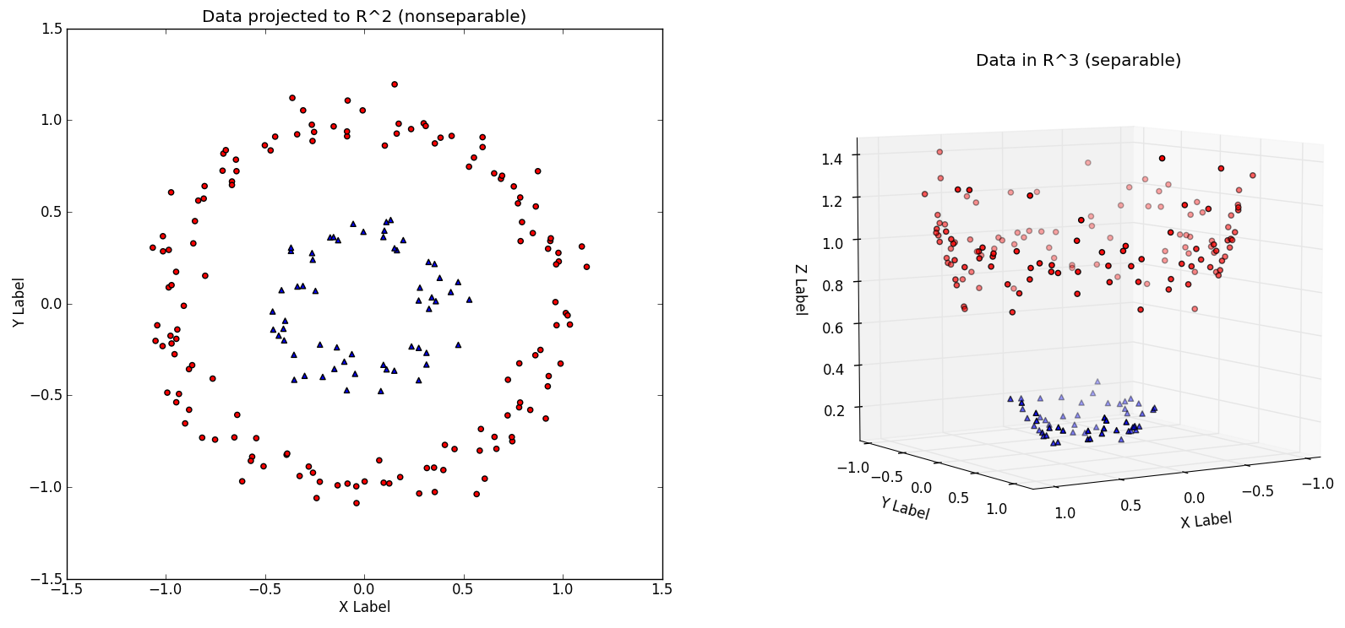
Limitations of Linear Single Layer Classifiers

Slide 36
Universal Approximation Theorem
“
A neural network with a single hidden layer of sufficient size
Can approximate any continuous function

Slide 37
Universal Approximation Theorem
There exists a true function relating the inputs to the outputs
A neural network can approximate this function to arbitrary precision given sufficient layer size
The required layer size can be extremely large and grow rapidly with the dimensionality of the problem
“
A neural network with a single hidden layer of sufficient size
Can approximate any continuous function

Slide 38
Universal Approximation Theorem
There exists a true function relating the inputs to the outputs
A neural network can approximate this function to arbitrary precision given sufficient layer size
The required layer size can be extremely large and grow rapidly with the dimensionality of the problem
“
A neural network with a single hidden layer of sufficient size
Can approximate any continuous function
Use of multiple hidden layers makes the NN vector representation of your problem increasingly more abstract
How do we train?
Compute grows (almost) exponentially

Slide 39
Predicting Housing Price
During the optimization process
The NN learns to encode a representation that maps
the input to the output

Slide 40
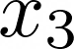
Predicting Housing Price
During the optimization process
The NN learns to encode a representation that maps
the input to the output

Slide 41
Predicting Housing Price
# beds
During the optimization process
The NN learns to encode a representation that maps
the input to the output
Size
Zip-Code
Wealth

Slide 42
Predicting Housing Price
# beds
?
During the optimization process
The NN learns to encode a representation that maps
the input to the output
Size
?
Zip-Code
?
Wealth

Slide 43
Predicting Housing Price
# beds
Family size
During the optimization process
The NN learns to encode a representation that maps
the input to the output
Size
?
Zip-Code
Wealth
School Quality

Slide 44
Predicting Housing Price
# beds
Family size
During the optimization process
The NN learns to encode a representation that maps
the input to the output
Size
?
Zip-Code
Transform the input to a space where we are able to separate the features
Wealth
School Quality

Slide 45
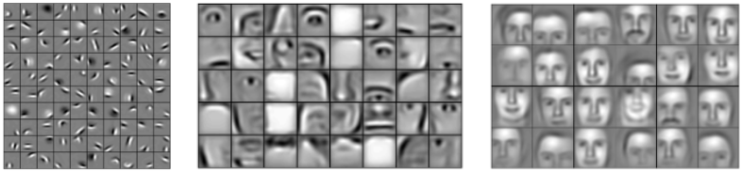
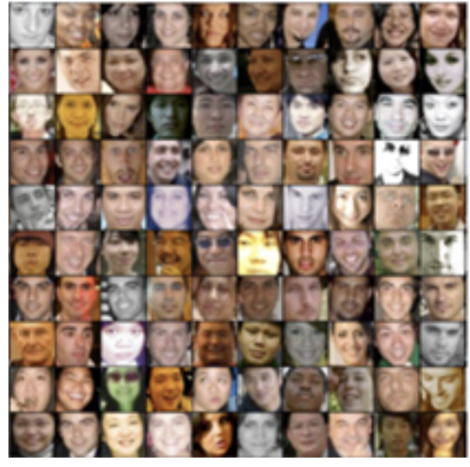
Predicting Faces
During the optimization process
The NN learns to encode a representation that maps
the input to the output
A deep neural network encodes the representation in an increasingly abstract way

Slide 46

Activation Functions
One of the reasons that enable NNs to encode highly abstract features is the use of non-linear activation functions.
Not using non-linearities leads to linear networks

Slide 47
Activation Functions
One of the reasons that enable NNs to encode highly abstract features is the use of non-linear activation functions.
Not using non-linearities leads to linear networks

Slide 48
Activation Functions
One of the reasons that enable NNs to encode highly abstract features is the use of non-linear activation functions.
Not using non-linearities leads to linear networks
Probability Estimate
Continuously differentiable
Vanishing derivatives due to saturated neurons

Slide 49
Activation Functions
One of the reasons that enable NNs to encode highly abstract features is the use of non-linear activation functions.
Not using non-linearities leads to linear networks
Probability Estimate
Continuously differentiable
Vanishing derivatives due to saturated neurons

Slide 50
Activation Functions
One of the reasons that enable NNs to encode highly abstract features is the use of non-linear activation functions.
Not using non-linearities leads to linear networks
Probability Estimate
Continuously differentiable
Vanishing derivatives due to saturated neurons
Very cheap to compute
Piece-wise linear functions
Dead neurons
Not differentiable at 0

Slide 51
Activation Functions
One of the reasons that enable NNs to encode highly abstract features is the use of non-linear activation functions.
Not using non-linearities leads to linear networks
Probability Estimate
Continuously differentiable
Vanishing derivatives due to saturated neurons
Very cheap to compute
Piece-wise linear functions
Dead neurons
Not differentiable at 0
Activation functions are applied to the output of each neuron (point-wise)
Simple derivative
Non-linear behaviour

Slide 52
Activation Functions
One of the reasons that enable NNs to encode highly abstract features is the use of non-linear activation functions.
Not using non-linearities leads to linear networks
Probability Estimate
Continuously differentiable
Vanishing derivatives due to saturated neurons
Very cheap to compute
Piece-wise linear functions
Dead neurons
Not differentiable at 0
Activation functions are applied to the output of each neuron (point-wise)
Simple derivative
Non-linear behaviour
ReLU made our lives much easier and faster
Most commonly used activation

Slide 53
Activation Functions
One of the reasons that enable NNs to encode highly abstract features is the use of non-linear activation functions.
Not using non-linearities leads to linear networks
Probability Estimate
Continuously differentiable
Vanishing derivatives due to saturated neurons
Very cheap to compute
Piece-wise linear functions
Dead neurons
Not differentiable at 0
Activation functions are applied to the output of each neuron (point-wise)
Simple derivative
Non-linear behaviour
ReLU made our lives much easier and faster
Most commonly used activation
Many more! We can design our own!

Slide 54
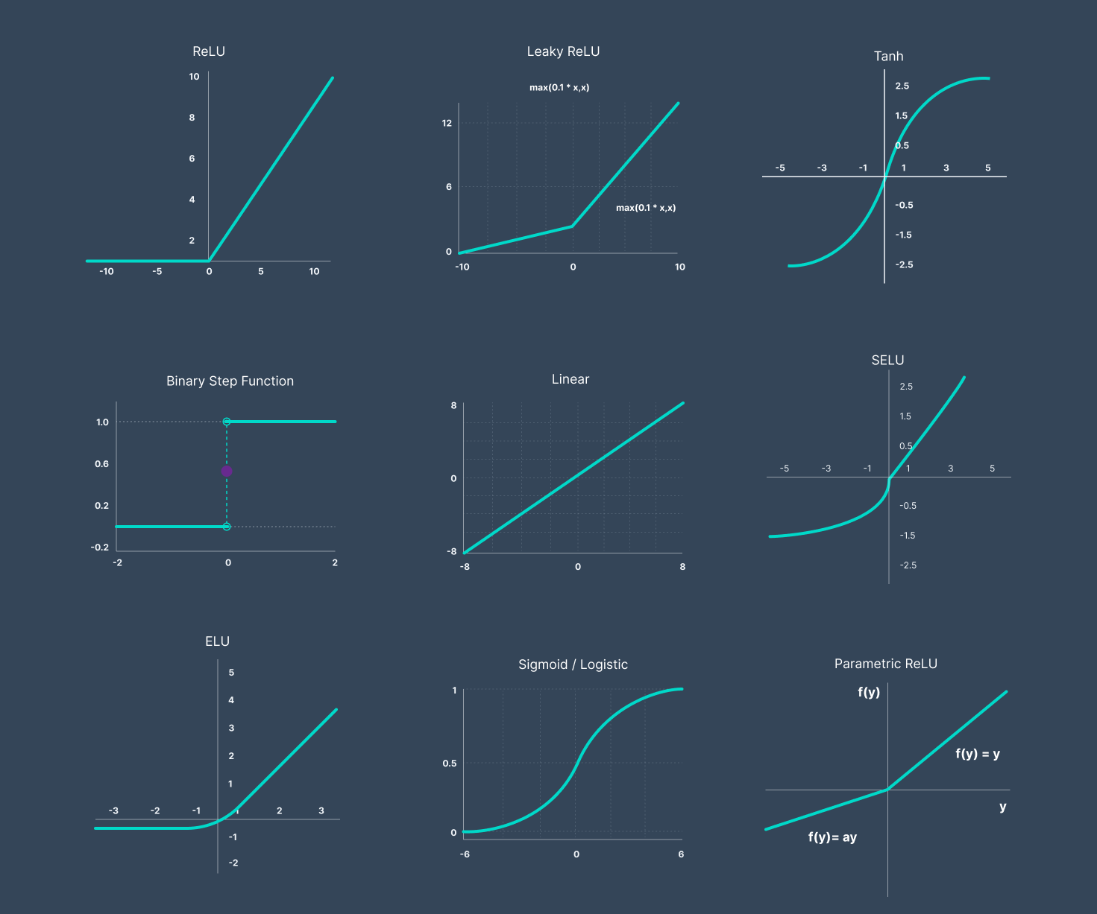
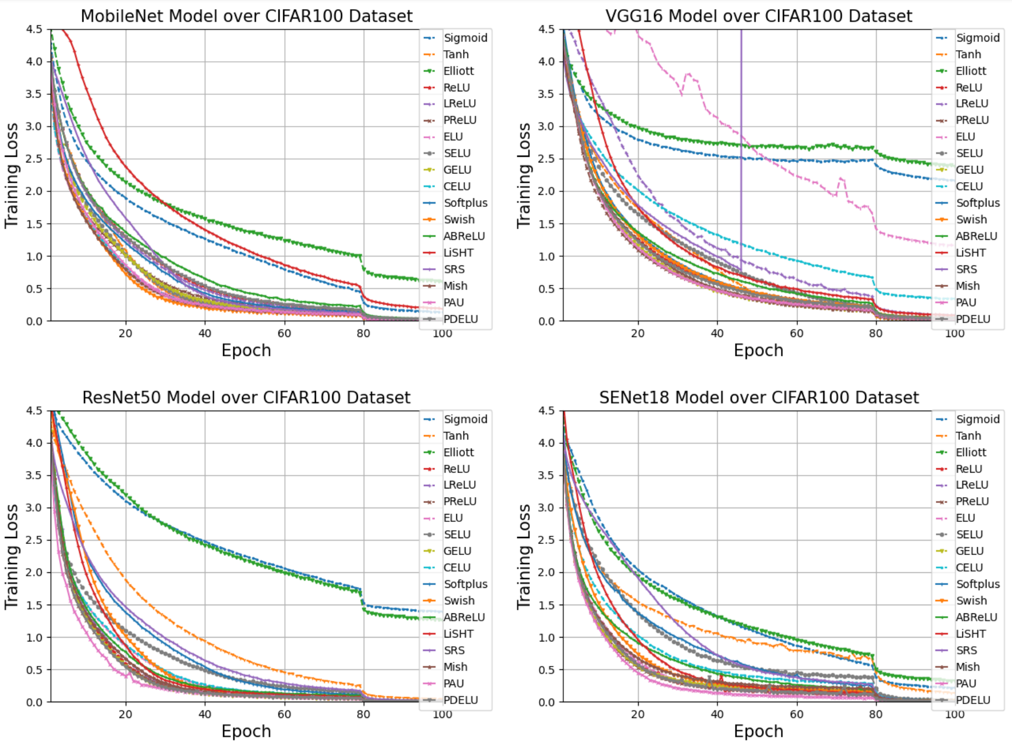
Activation Functions
Many more! We can design our own!

Slide 55
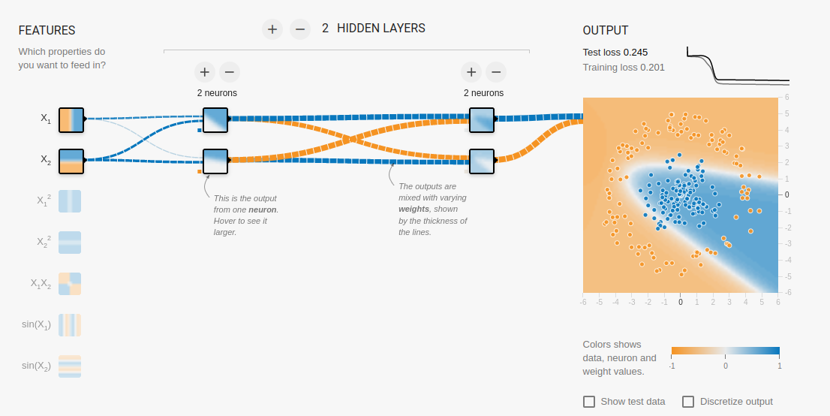
Neural Network Demo
https://playground.tensorflow.org/

Slide 56
Neural Network
The output of previous layer is used as an input to the next layer
The input layer is data input and the output is a prediction
Anything in between is hidden
Layers are represented as vectors
Edges are matrices
We train the weights

Slide 57
11/01/2023
Neural Network Training
High Performance Machine Learning Group

Slide 58
Recipe for Training
01.
02.
03.
04.
What function to optimize?
Define the function to approximate
your desired solution
How to evaluate the model?
Which metrics are going to tell us how well we are doing on unseen data?
Process your data
Define the data to be used
Do we have labels?
Define the Model
Define the layers and
The forward propagation

Slide 59
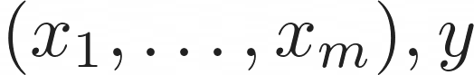
Recipe for Training
01.

Slide 60
Recipe for Training
01.
02.

Slide 61
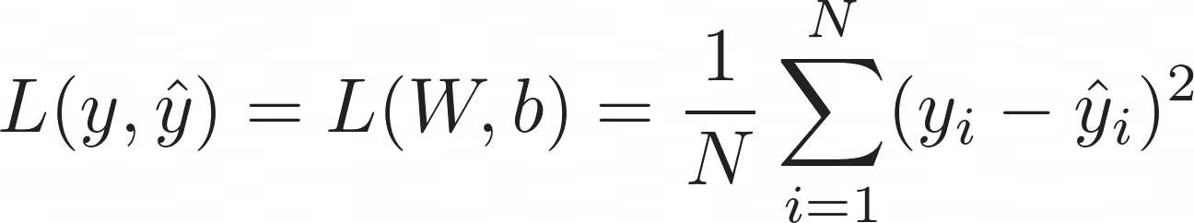
Recipe for Training
01.
02.
03.
MSE

Slide 62
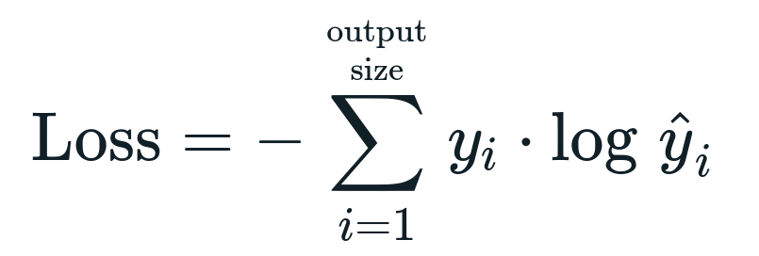
Recipe for Training
01.
02.
03.
MSE
CE

Slide 63
Recipe for Training
01.
02.
03.
04.
MSE
CE
Accuracy, F1-score, precision, recall

Slide 64
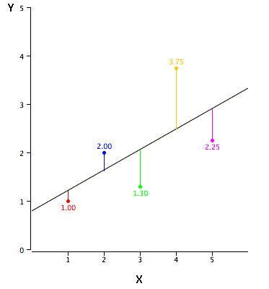
Loss Functions
The loss function is used to bridge the gap between
your neural network predictions and the true value
We optimize (minimize) the loss to tune the weights
In the direction of biggest positive change

Slide 65
Loss Functions
The loss function is used to bridge the gap between
your neural network predictions and the true value
We optimize (minimize) the loss to tune the weights
In the direction of biggest positive change
Distance/statistical metric assumes a Gaussian prior
Easy to understand, easy to
Compute
Prone to outliers
Not suitable for classification
problems

Slide 66
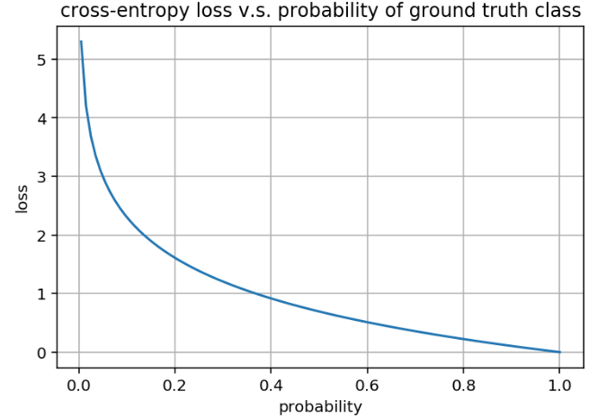
Loss Functions
The loss function is used to bridge the gap between
your neural network predictions and the true value
We optimize (minimize) the loss to tune the weights
In the direction of biggest positive change
Distance/statistical metric assumes a Gaussian prior
Easy to understand, easy to
Compute
Prone to outliers
Not suitable for classification
problems

Slide 67
Loss Functions
The loss function is used to bridge the gap between
your neural network predictions and the true value
We optimize (minimize) the loss to tune the weights
In the direction of biggest positive change
Distance/statistical metric assumes a Gaussian prior
Easy to understand, easy to
Compute
Prone to outliers
Not suitable for classification
problems
Suitable for multi-class
problems
Information theory foundation
Not exactly the most stable loss

Slide 68
Loss Functions
The loss function is used to bridge the gap between
your neural network predictions and the true value
We optimize (minimize) the loss to tune the weights
In the direction of biggest positive change
CE is easily composed with sigmoid
Or Softmax activations!
CE and Softmax has better behaved
gradients.
Non-linear behaviour
Distance/statistical metric assumes a Gaussian prior
Easy to understand, easy to
Compute
Prone to outliers
Not suitable for classification
problems
Suitable for multi-class
problems
Information theory foundation
Not exactly the most stable loss

Slide 69
Loss Functions
The loss function is used to bridge the gap between
your neural network predictions and the true value
We optimize (minimize) the loss to tune the weights
In the direction of biggest positive change
CE is easily composed with sigmoid
Or Softmax activations!
CE and Softmax has better behaved
gradients.
Non-linear behaviour
CE is the negative
log-likelihood
Most commonly used activation for
classification
Distance/statistical metric assumes a Gaussian prior
Easy to understand, easy to
Compute
Prone to outliers
Not suitable for classification
problems
Suitable for multi-class
problems
Information theory foundation
Not exactly the most stable loss

Slide 70
Loss Functions
The loss function is used to bridge the gap between
your neural network predictions and the true value
We optimize (minimize) the loss to tune the weights
In the direction of biggest positive change
CE is easily composed with sigmoid
Or Softmax activations!
CE and Softmax has better behaved
gradients.
Non-linear behaviour
CE is the negative
log-likelihood
Most commonly used activation for
classification
Distance/statistical metric assumes a Gaussian prior
Easy to understand, easy to
Compute
Prone to outliers
Not suitable for classification
problems
Suitable for multi-class
problems
Information theory foundation
Not exactly the most stable loss
Many more! We can design our own!

Slide 71
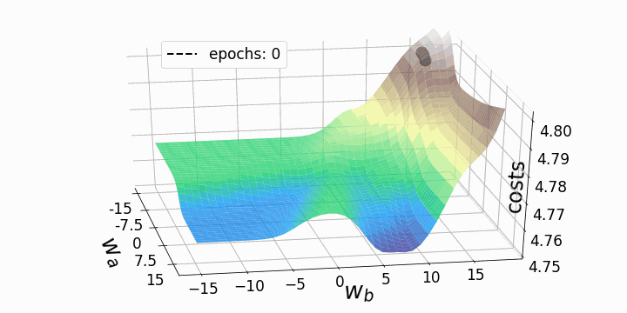
Stochastic Gradient Descent
01.

Slide 72
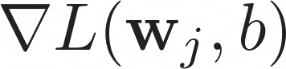
Stochastic Gradient Descent
01.
02.

Slide 73
Stochastic Gradient Descent
01.
02.
Create batches of N examples to propagate
and compute
03.

Slide 74
Stochastic Gradient Descent
01.
02.
Create batches of N examples to propagate
and compute
03.
04.

Slide 75
Stochastic Gradient Descent
01.
02.
Create batches of N examples to propagate
and compute
03.
04.
Learning Rate
Choice of learning rate critical
SGD is the main engine behind training
Many variations exist

Slide 76
Stochastic Gradient Descent
01.
02.
Create batches of N examples to propagate
and compute
03.
04.
Learning Rate
Choice of learning rate critical
SGD is the main engine behind training
Many variations exist
Can be used with loss function that are not differentiable
No Guarantee that we find the global optimum

Slide 77

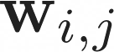
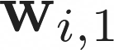
Backpropagation
A (deep) neural network is a deeply nested functions:
We need to compute the gradient for each layer
Apply the chain rule
This is backpropagation
…
…

Slide 78
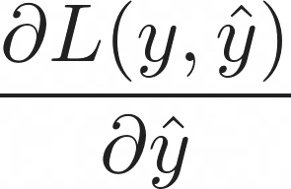
Backpropagation
A (deep) neural network is a deeply nested functions:
We need to compute the gradient for each layer
Apply the chain rule
This is backpropagation
…
…

Slide 79
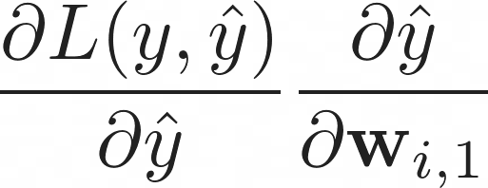
Backpropagation
A (deep) neural network is a deeply nested functions:
We need to compute the gradient for each layer
Apply the chain rule
This is backpropagation
…
…

Slide 80
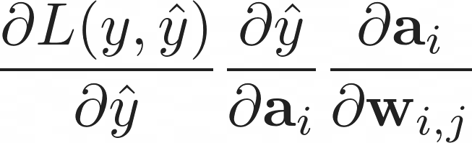
Backpropagation
A (deep) neural network is a deeply nested functions:
We need to compute the gradient for each layer
Apply the chain rule
This is backpropagation
…
…

Slide 81

Combatting Overfitting

Slide 82

Combatting Overfitting

Slide 83
Combatting Overfitting
Dropout prior
Weight decay
Early stopping
Batch Normalization

Slide 84
Combatting Overfitting
Dropout prior
Weight decay
Early stopping
Batch Normalization
The more weights we need to train, the more complex the model becomes and the sooner it starts to memorize, if we don’t have enough data

Slide 85

Combatting Overfitting
Dropout prior
Weight decay
Early stopping
Batch Normalization

Slide 86

Combatting Overfitting
Dropout prior
Weight decay
Early stopping
Batch Normalization

Slide 87

Combatting Overfitting
Dropout prior
Weight decay
Early stopping
Batch Normalization

Slide 88
Combatting Overfitting
Dropout prior
Weight decay
Early stopping
Batch Normalization
Models always need regularization no matter how big
Not entirely understood how all these tricks amount to a more complex separating hyperplane

Slide 89

Optimizers
In what way should we change the weights?

Slide 90


Optimizers
In what way should we change the weights?

Slide 91
11/01/2023
ML Workflow
Artificial Intelligence still heavily relies on human intelligence
High Performance Machine Learning Group

Slide 92

Imbalanced Training set

Slide 93

Imbalanced Training set

Slide 94


Data normalization
A process to transform the input data in a well-behaved form

Slide 95

Open Datasets
Processed, balanced, well-behaved and labelled datasets
tensorflow.org/datasets
kaggle.com/datasets
topepo.github.io/caret/data-sets.html
github.com/awesomedata/awesome-public-datasets

Slide 96

Dataset Splitting
70%
20%
10%

Slide 97


Network Evaluation
Choose an appropriate metric for your own problem
Always sanity check your model, is it better than a baseline?
An almost perfect classification score is always sketchy
Keep questioning the model, never trust it

Slide 98

Workflow

Slide 99
11/01/2023
DL Frameworks
Do not compute your own gradients
High Performance Machine Learning Group

Slide 100


How to train your NN
Define neurons and layers
Define loss function
Forward propagate and compute loss
Compute gradient
Propagate backward
Update weights

Slide 101
PyTorch and Modularity

Slide 102

Three Levels of Abstraction
Tensor: imperative ndarray, possible to run on GPU/TPU
(node) Variable: Node in the built computational graph; data, gradient storage
(NN) Module: A neural network layer, store the state and the weights of the neural network

Slide 103
Three Levels of Abstraction
Tensor: imperative ndarray, possible to run on GPU/TPU
(node) Variable: Node in the built computational graph; data, gradient storage
(NN) Module: A neural network layer, store the state and the weights of the neural network

Slide 104
Three Levels of Abstraction
Tensor: imperative ndarray, possible to run on GPU/TPU
(node) Variable: Node in the built computational graph; data, gradient storage
(NN) Module: A neural network layer, store the state and the weights of the neural network

Slide 105
Three Levels of Abstraction
Tensor: imperative ndarray, possible to run on GPU/TPU
(node) Variable: Node in the built computational graph; data, gradient storage
(NN) Module: A neural network layer, store the state and the weights of the neural network

Slide 106

Three Levels of Abstraction
Tensor: imperative ndarray, possible to run on GPU/TPU
(node) Variable: Node in the built computational graph; data, gradient storage
(NN) Module: A neural network layer, store the state and the weights of the neural network

Slide 107
Three Levels of Abstraction
Tensor: imperative ndarray, possible to run on GPU/TPU
(node) Variable: Node in the built computational graph; data, gradient storage
(NN) Module: A neural network layer, store the state and the weights of the neural network
X
dot
+
relu
dot
W_1
b_1
W_2
b_2

Slide 108
Three Levels of Abstraction
Tensor: imperative ndarray, possible to run on GPU/TPU
(node) Variable: Node in the built computational graph; data, gradient storage
(NN) Module: A neural network layer, store the state and the weights of the neural network
X
dot
+
relu
dot
+
Exp
W_1
b_1
W_2
b_2
Sum
Div
log
y
dot
neg

Slide 109
Three Levels of Abstraction
Tensor: imperative ndarray, possible to run on GPU/TPU
(node) Variable: Node in the built computational graph; data, gradient storage
(NN) Module: A neural network layer, store the state and the weights of the neural network
X
dot
+
relu
dot
+
Exp
W_1
b_1
W_2
b_2
Sum
Div
log
y
dot
neg

Slide 110
Three Levels of Abstraction
Tensor: imperative ndarray, possible to run on GPU/TPU
(node) Variable: Node in the built computational graph; data, gradient storage
(NN) Module: A neural network layer, store the state and the weights of the neural network
X
dot
+
relu
dot
+
Exp
W_1
b_1
W_2
b_2
Sum
Div
log
y
dot
neg
Pytorch will helps us with
Defining a dataset
Automatic Gradient Computation
Defining Neural Networks
Optimization
Scheduling
Distributing

Slide 111

https://pytorch.org/docs/stable/

Slide 112
General Training Structure
data loader
model
optimizer
loss function

Slide 113
General Training Structure
data loader
model
optimizer
loss function
For every datapoint, y in data_loader

Slide 114
General Training Structure
data loader
model
optimizer
loss function
For every datapoint, y in data_loader
optimizer.zero_grad()

Slide 115
General Training Structure
data loader
model
optimizer
loss function
For every datapoint, y in data_loader
optimizer.zero_grad()
prediction = model(datapoint)

Slide 116
General Training Structure
data loader
model
optimizer
loss function
For every datapoint, y in data_loader
optimizer.zero_grad()
prediction = model(datapoint)
loss = loss_function(prediction, y)

Slide 117
General Training Structure
data loader
model
optimizer
loss function
For every datapoint, y in data_loader
optimizer.zero_grad()
prediction = model(datapoint)
loss = loss_function(prediction, y)
loss.backward()

Slide 118
General Training Structure
data loader
model
optimizer
loss function
For every datapoint, y in data_loader
optimizer.zero_grad()
prediction = model(datapoint)
loss = loss_function(prediction, y)
loss.backward()
optimizer.step()

Slide 119

General Training Structure
data loader
model
optimizer
loss function
For every datapoint, y in data_loader
optimizer.zero_grad()
prediction = model(datapoint)
loss = loss_function(prediction, y)
loss.backward()
optimizer.step()

Slide 120
Data:
d_1 = [0.9, -0.2], y = 0
d_2 = [0.75, 0.6],y = 1

Slide 121
Data:
d_1 = [0.9, -0.2], y = 0
d_2 = [0.75, 0.6],y = 1
Define Neural Network
Input size of 2
One hidden layer of 8 nodes
1 output node (binary)

Slide 122
Data:
d_1 = [0.9, -0.2], y = 0
d_2 = [0.75, 0.6],y = 1
Define Neural Network
Input size of 2
One hidden layer of 8 nodes
1 output node (binary)
Learning rate = 0.01
Optimizer = Stochastic Gradient Descent
Loss = Binary Cross Entropy

Slide 123
Data:
d_1 = [0.9, -0.2], y = 0
d_2 = [0.75, 0.6],y = 1
Define Neural Network
Input size of 2
One hidden layer of 8 nodes
1 output node (binary)
Learning rate = 0.01
Optimizer = Stochastic Gradient Descent
Loss = Binary Cross Entropy

Slide 124


Data:
d_1 = [0.9, -0.2], y = 0
d_2 = [0.75, 0.6],y = 1
Define Neural Network
Input size of 2
One hidden layer of 8 nodes
1 output node (binary)
Learning rate = 0.01
Optimizer = Stochastic Gradient Descent
Loss = Binary Cross Entropy

Slide 125
HPML Group 11/01/2023
Fin
Introduction Series
https://jupyter.snellius.surf.nl/jhssrf004
Bryan Cardenas
Monica Rotulo
Caspar van Leeuwen
Robert Jan Schlimbach

